Slide 1

NETWORK
ANALYSIS
Swathi Yemmanur, Data Scientist, Advanced Analytics
Laavanya Ganesh; 2017 Advanced Analytical Services Summer Intern, Predictive Analytics

Slide 2

AS INTERCONNECTIVITY GROWS STRONGER IN THE WORLD OF TECHNOLOGY,
SO DOES THE RISK ASSOCIATED WITH RELATIONSHIPS

Slide 3

ROADMAP
Phase 1
- Path of propagation of cyber risk in a supply chain network
Phase 2
-Identify communities in a network of industries
Phase 3
- Identify inter-dependencies in industries that are co-located

Slide 4
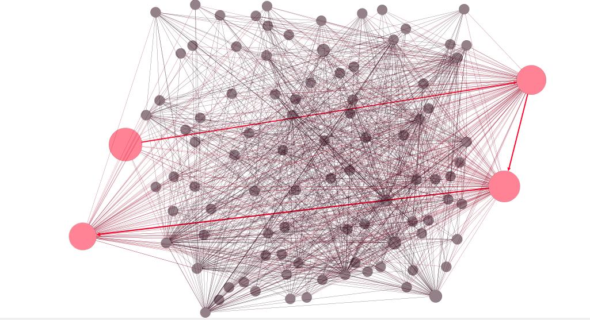

Slide 5
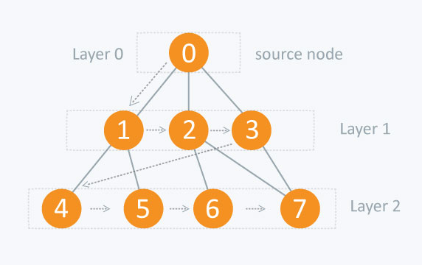
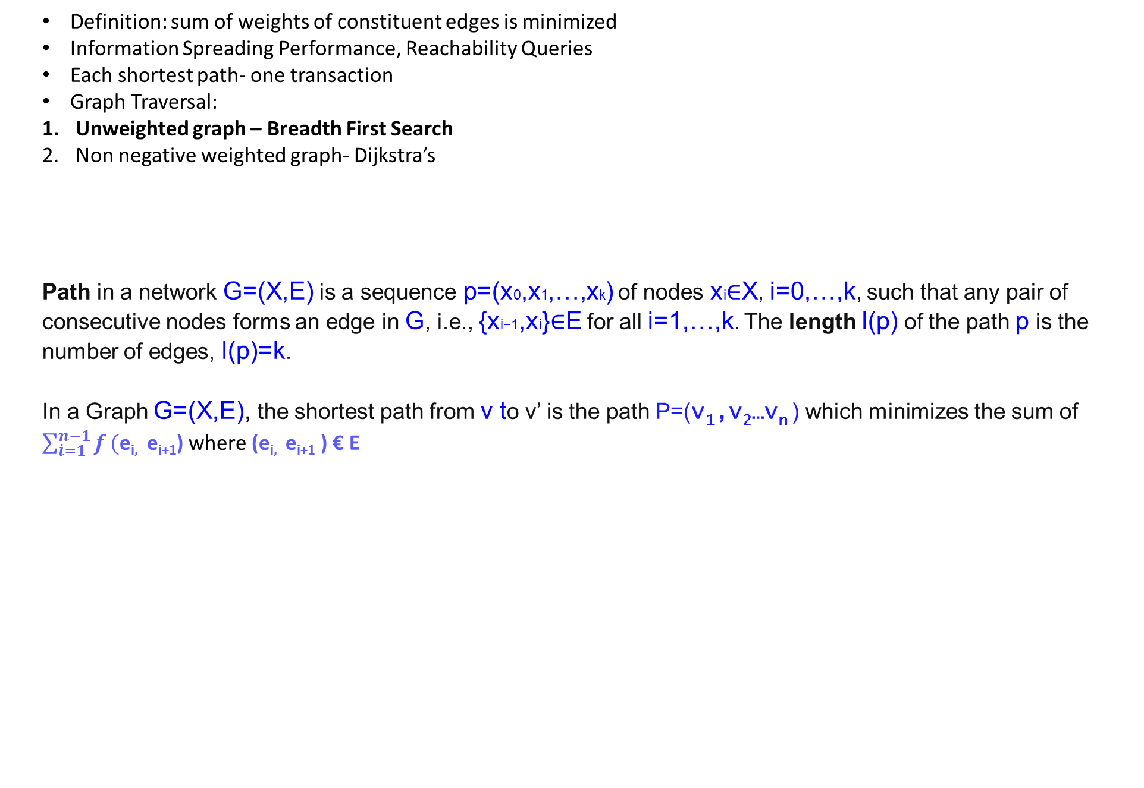
SHORTEST PATHS
Definition: sum of weights of constituent edges is minimized
Information Spreading Performance, Reachability Queries
Each shortest path- one transaction
Graph Traversal:
Unweighted graph – Breadth First Search
Non negative weighted graph- Dijkstra’s
Path in a network G=(X,E) is a sequence p=(x0,x1,…,xk) of nodes xi∈X, i=0,…,k, such that any pair of consecutive nodes forms an edge in G, i.e., {xi−1,xi}∈E for all i=1,…,k. The length l(p) of the path p is the number of edges, l(p)=k.
In a Graph G=(X,E), the shortest path from v to v’ is the path P=(v₁,v₂…v_{n} ) which minimizes the sum of $\sum_{\dot{i}=1}^{n−1}{f}(\text{e}\text{i}\text{, }\text{ei}\text{+1}$) where (e_{i,} e_{i+1} ) € E

Slide 6
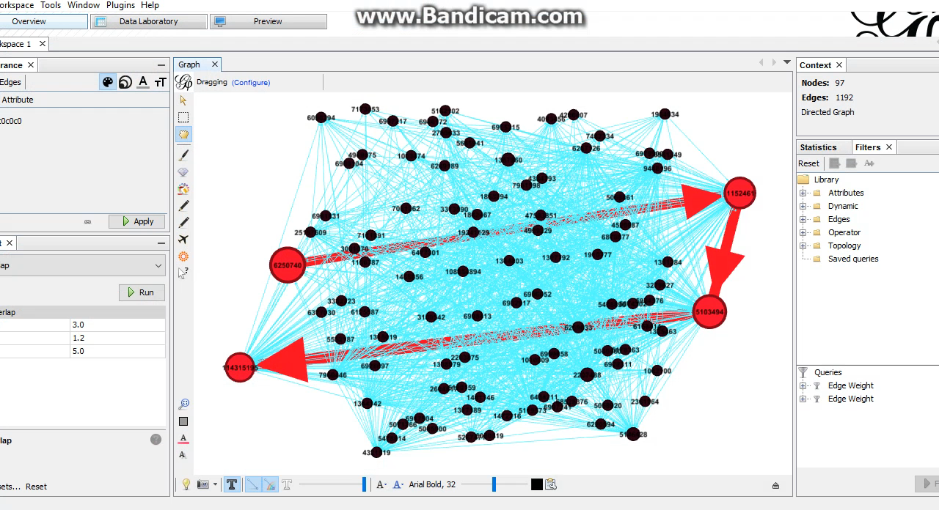

Slide 7
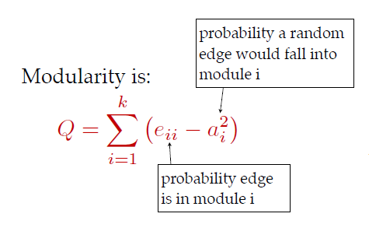
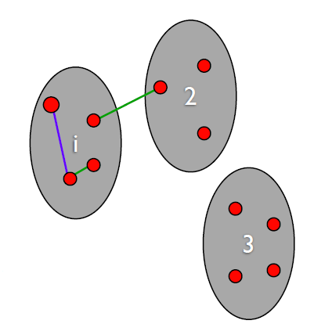
MODULARITY
Modularity: Strength of division
Between and Within communities
e_{ii} : % of edges in module I
e_{ii} =|{(u,v) : u ∈ Vi, v ∈ Vi, (u,v)∈E}| / |E|
a_{i} : % of edges with atleast one end in module I
a_{i} =|{(u,v) : u ∈ Vi, (u,v) ∈ E}| / |E|
Configuration model: edge connection probabilities are based on the current graph’s degree distribution.

Slide 8
COMMUNITY DETECTION ALGORITHMS
TYPES
OF ALGORITHMS
Based on SHORT RANDOM WALKS
Based on HIERARCHIAL DECOMPOSITION
Based on INFORMATION THEORETIC PRINCIPLES
Based on STATISTICAL MECHANICS
MODULARITY: 0.1022649
COMMUNITIES: 5
Algorithms Based on multilevel community, influence of vertices in path and neighborhood of vertices:
only for Undirected Graphs and
Algorithms based on modularity optimization:
graphs having a maximum of 100 vertices

Slide 9
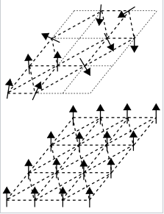
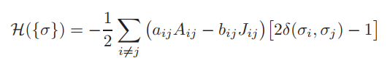
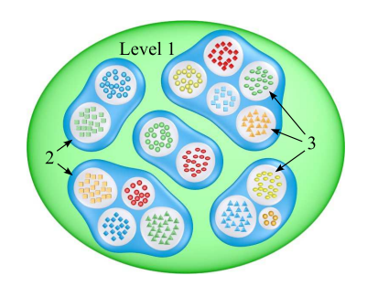
COMMUNITY DETECTION BASED ON STATISTICAL MECHANICS
Statistical Physics
- spin: angular momentum of elementary particles, atoms
Potts model: disordered magnet ; alignment of atomic particles in a magnet
Spin states: define communities
Associated Energy: Quality of Partition; energy density
Accurate, robust to noise, competitive in terms of computational speed

Slide 10
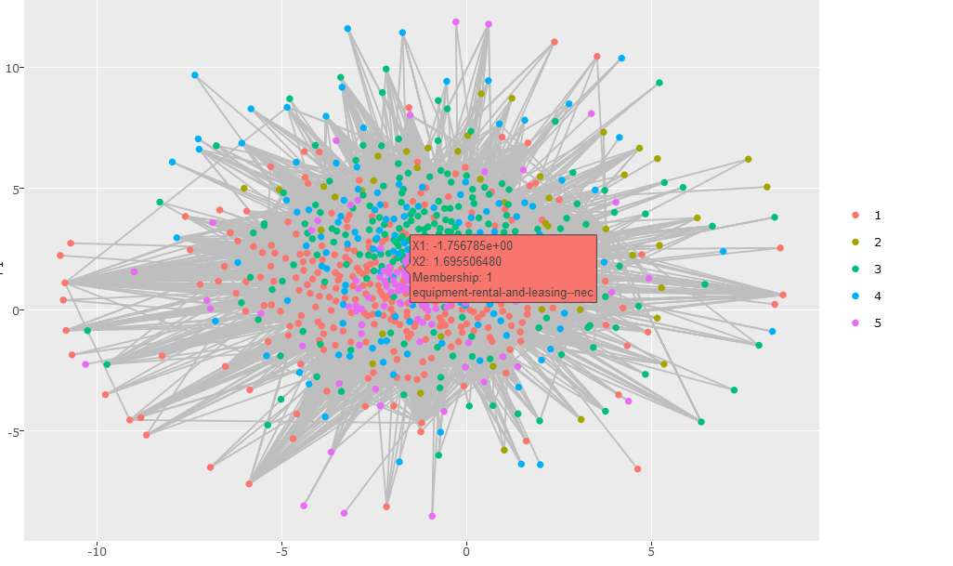
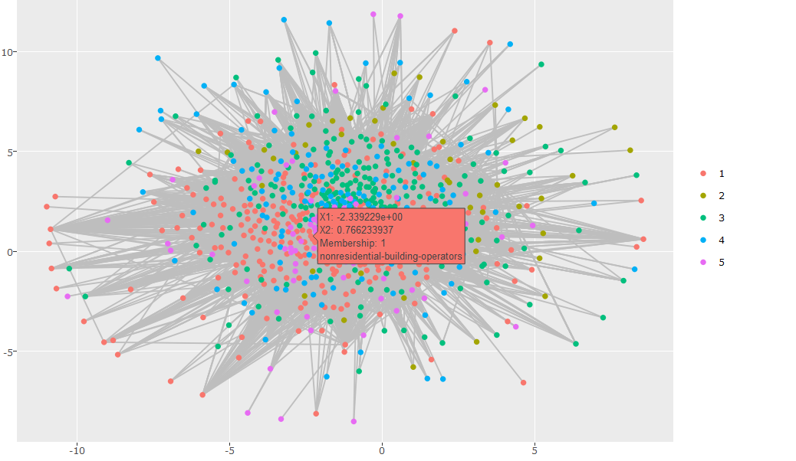
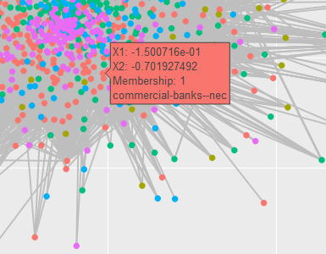
MEMBERSHIP | 1 | 2 | 3 | 4 | 5
COUNT | 293 | 49 | 247 | 166 | 146

Slide 11
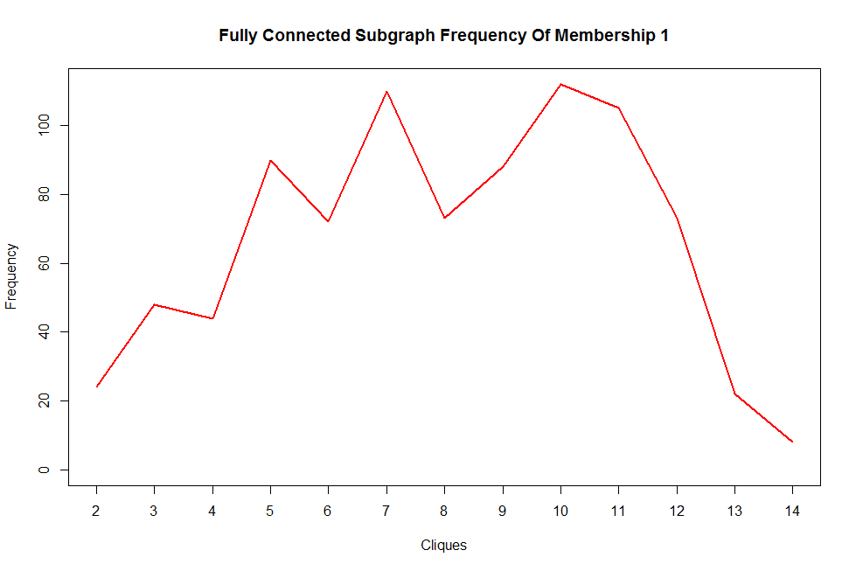
Subcomponents | 2 | 3 | 4 | 5 | 6 | 7 | 8 | 9 | 10 | 11 | 12 | 13 | 14
Frequency | 24 | 48 | 44 | 90 | 72 | 110 | 73 | 88 | 112 | 105 | 73 | 22 | 8
Members in one of the 8 communities with 14 nodes each:
nonresidental-building-operators
executive-offices
electronic-computers
telephone-communication-except-radio
lumber-and-other-building-materials
real-estate-agents-and-managers
nonresidential-construction—nec
business-services—nec
commercial-printing--lithographic
miscellaneous-business-credit
radiotelephone-communication
national-commercial-banks
data-processing-and-preparation
electric-services

Slide 12
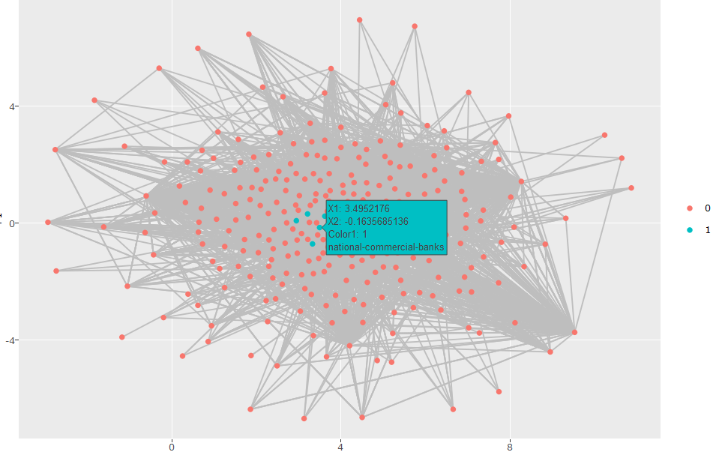

Slide 13
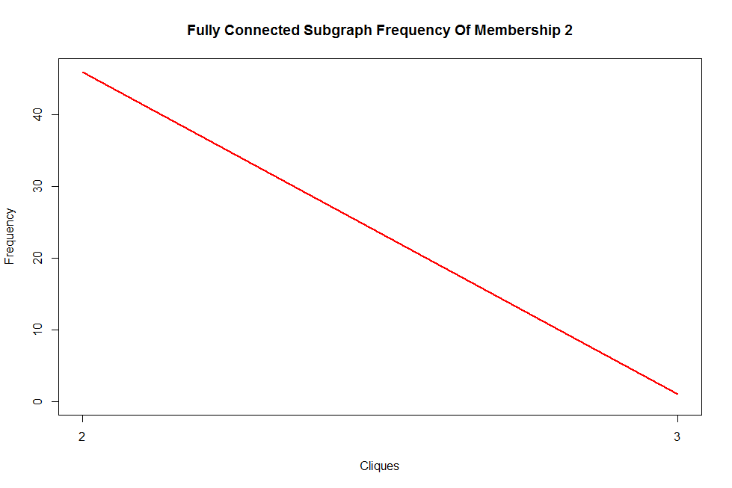
Subcomponents | 2 | 3
Frequency | 46 | 1
Members in the community with 3 nodes:
diagnostic-substances
electrical-apparatus-and-equipment
brooms-and-brushes

Slide 14
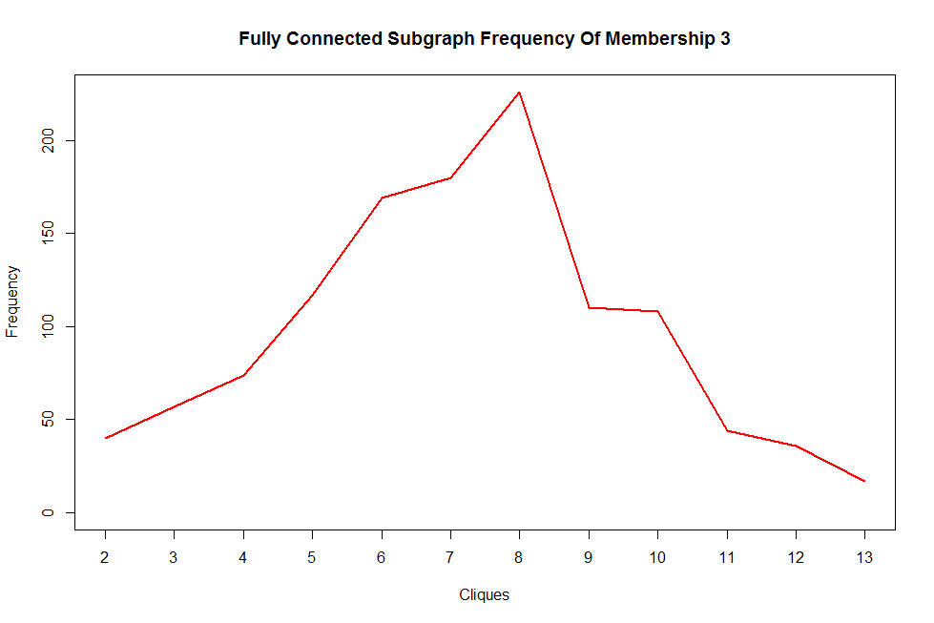
Subcomponents | 2 | 3 | 4 | 5 | 6 | 7 | 8 | 9 | 10 | 11 | 12 | 13
Frequency | 40 | 57 | 74 | 117 | 169 | 180 | 226 | 110 | 108 | 44 | 36 | 17
Members in one of the 17 communities with 13 nodes each:
current-carrying-wiring-devices
trucking--except-local
metals-service-centers-and-offices
relays-and-industrial-controls
plastics-products—nec
industrial-supplies
aircraft-engines-and-engine-parts
electronic-parts-and-equipment—nec
industrial-machinery-and-equipment
search-and-navigation-equipment
electronic-components—nec
measuring-and-controlling-devices--nec instruments-to-measure-electricity

Slide 15
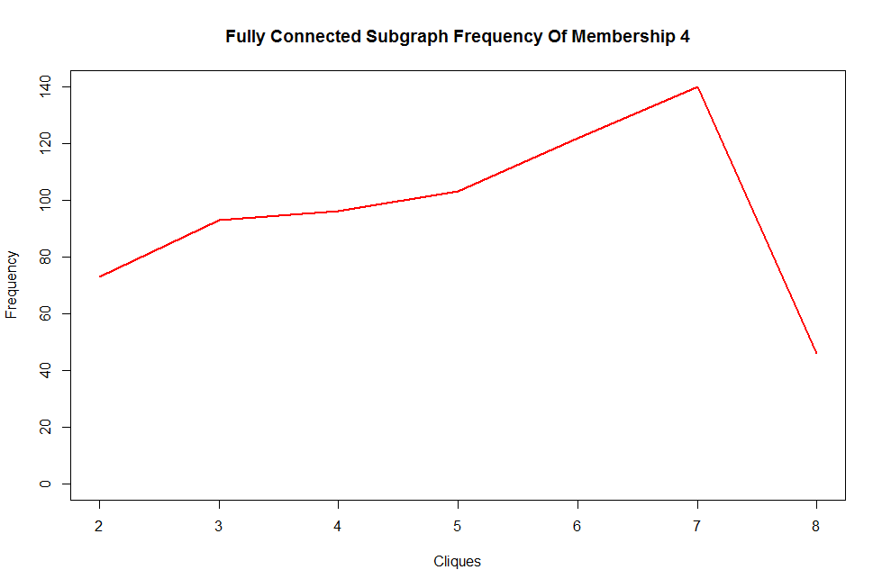
Subcomponents | 2 | 3 | 4 | 5 | 6 | 7 | 8
Frequency | 73 | 93 | 96 | 103 | 122 | 140 | 46
Members in one of the 46 communities with 8 nodes each:
fuel-oil-dealers
freight-transportation-arrangement
groceries-and-related-products—nec
department-stores
catalog-and-mail-order-houses
flavoring-extracts-and-syrups—nec
auto-and-home-supply-stores
eating-places

Slide 16
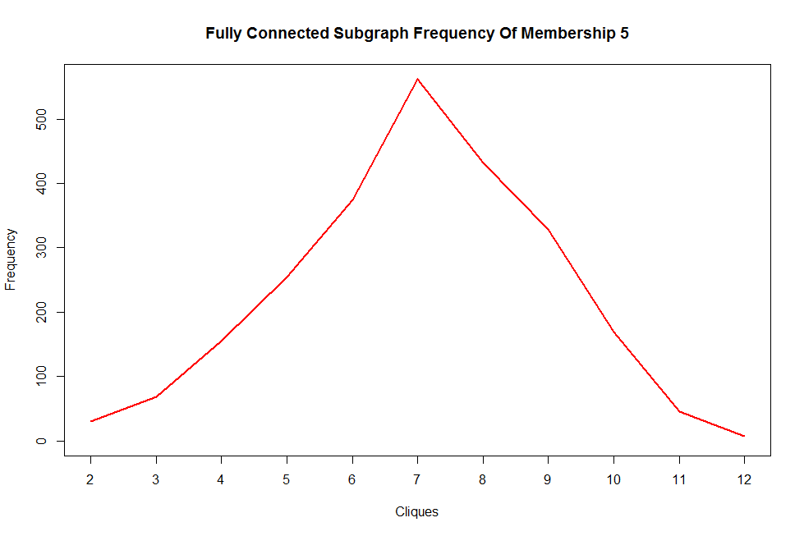
Subcomponents | 2 | 3 | 4 | 5 | 6 | 7 | 8 | 9 | 10 | 11 | 12
Frequency | 31 | 69 | 155 | 255 | 375 | 562 | 432 | 329 | 169 | 46 | 7
Members in one of the 7 communities with 12 nodes each:
membership-organizations—nec
colleges-and-universities
prepackaged-software
life-insurance
custom-computer-programming-services
security-brokers-and-dealers
computer-integrated-systems-design
business-consulting—nec
book-publishing
photographic-equipment-and-supplies
stationery-stores
signs-and-advertising-speciliaties

Slide 17

THANK YOU

